Slide 1
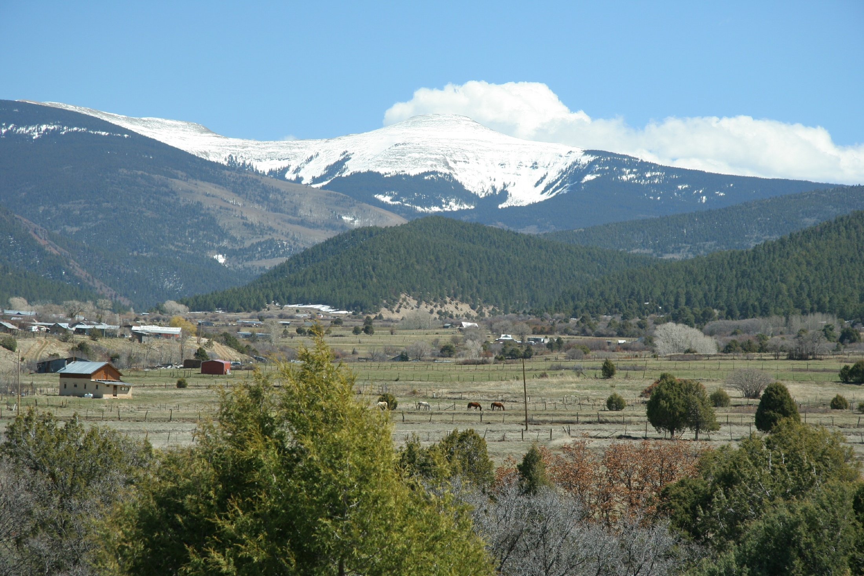
Why I sing songs in Spanish!
The music and lyrics touch my heart.
I feel like I belong.
The harmonies and melodies are beautiful.
My own language and culture is reflected.
They are the products of the most creative minds in my culture.
I am proud to be a Manito

Slide 2
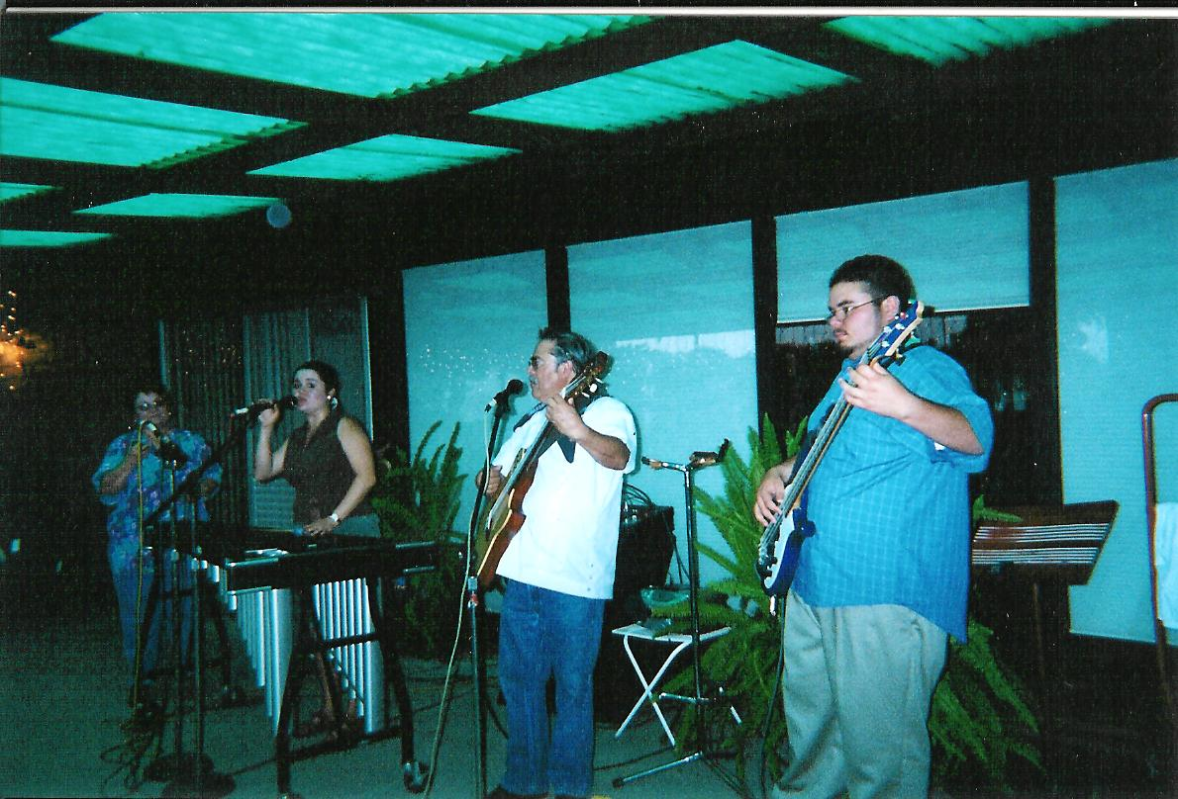
Music skills
Rhythm, pitch, timing, intonation, voice projection, musical balance, volume control, color, voice
Performing as one group instead of many individuals
Stage presentations skills and stage presence

Slide 3
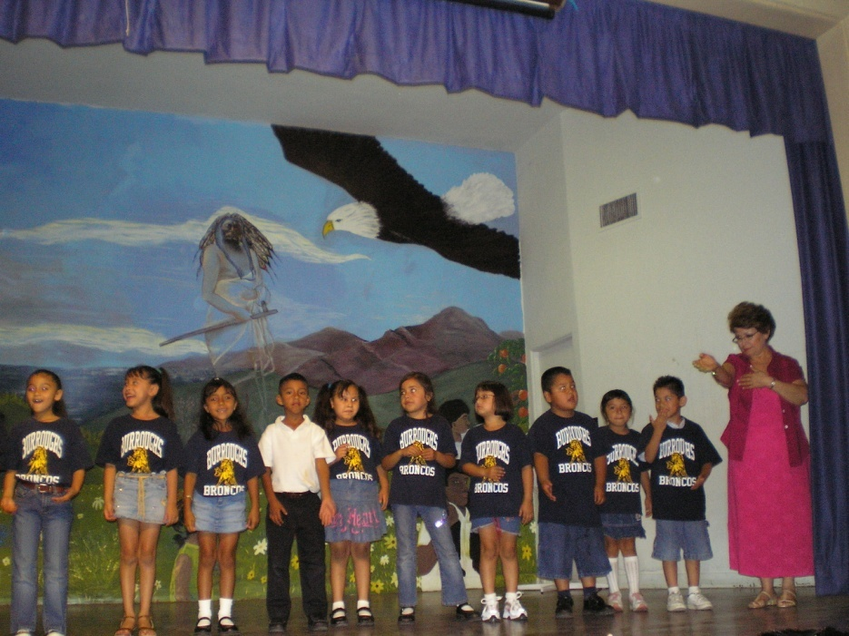
Personal skills
Self confidence
Self discipline
Memorization
Cultural awareness

Slide 4
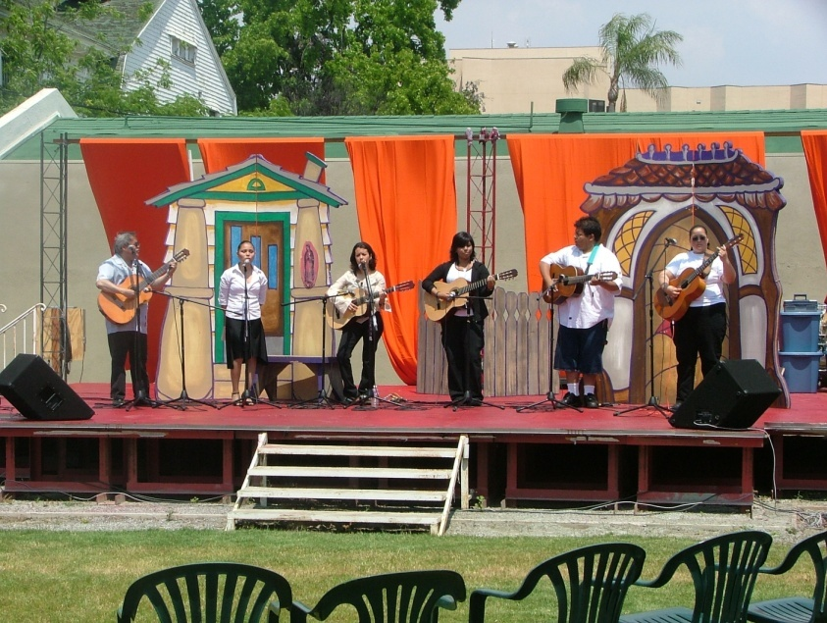
Community benefits
Preservation of our musical cultural heritage
Home and school connection
Pride in our culture
To remember our ancestors
Cultural values reflected in songs

