Slide 1
New Mexico History
Through Genealogy
Estanlislao Andrés Lucero
Thursday, November 5, 2015
La Cosecha 2015 Albuquerque, New Mexico

Slide 2
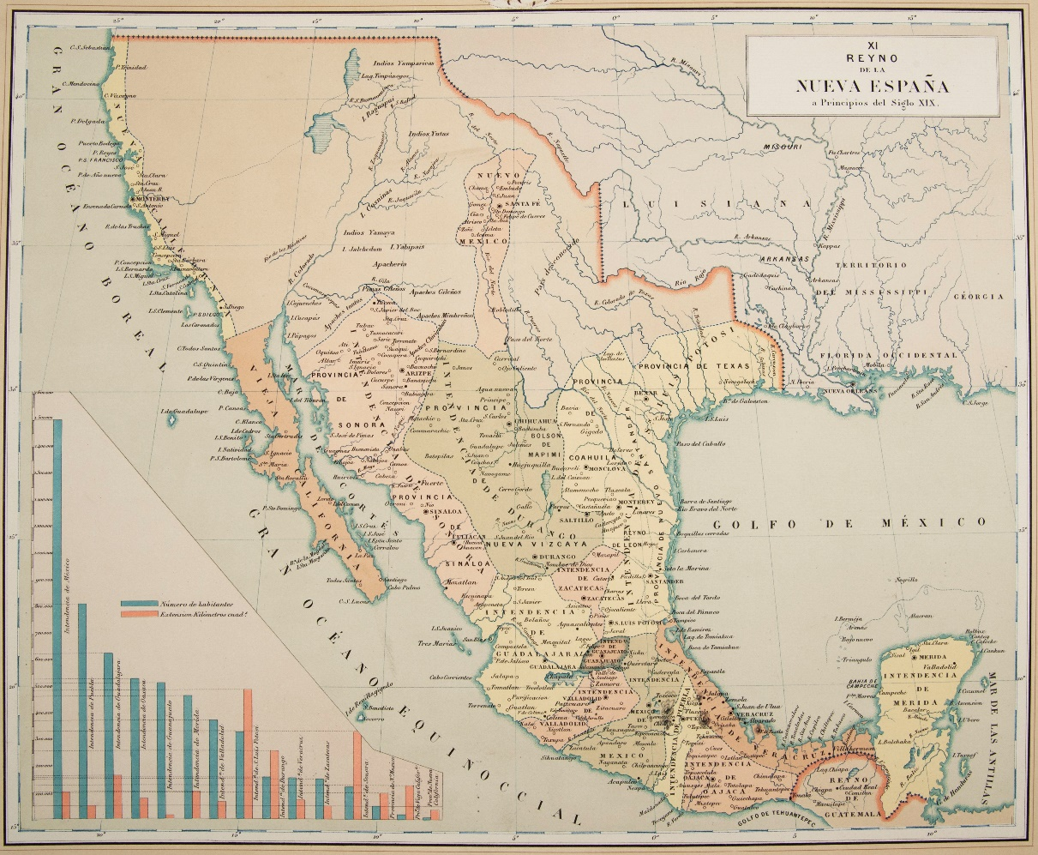
I am a Manito, a genízaro, a coyote, a Spanish American with deep roots in New Mexico with both Native American and European ancestors. As I traced my ancestors, I also learned about the places where they settled including: Analco, Atlixco, Bernalillo, San Gabriel del Yunque, Cerro de Chimayo de Buenaventura, and many others.
www.thecelebritypix.com

Slide 3
Defining Manito, genizaro, and coyote.

Slide 4
Los Manitos
A Dictionary of New Mexico and Southern Colorado Spanish, p. 105
“Los Manitos, the New Mexicans, a term applied by Mexican immigrants to northern New Mexicans of Indo-Hispano descent.”
“[<Mex. Sp. dim. of mano<hermano]”

Slide 5
Los Jenízaros
A Dictionary of New Mexico and Southern Colorado Spanish, p. 90
“A person of mixed blood, an Indian captive ransomed by the Spanish authorities from the Apache, Comanche, Navajo, or Ute masters and used by his rescuers as a domestic or soldier; also, a descendant of these ransomed Indians.”

Slide 6
Genizaro Federation of New Mexico https://www.facebook.com/groups/genizaro.federation.of.New.Mexico/886493474733140
FACEBOOK: Organization of Genízaro Descendants of New Mexico and their friends and supporters. Membership in this group or connection to this page is not limited to those of Genizaro Ancestry.

Slide 7
Los coyotes
A Dictionary of New Mexico and Southern Colorado Spanish, p. 97
“Said of the youngest child in a family; offspring of a mixed Anglo-American Indo-Hispanic marriage; native, of the country [criollo]; indios coyotes, native Indians, i.e. from Cibola, lands that eventually [after 1583] became the kingdom of New Mexico.”

Slide 8
Topics to consider
Teach our children about their direct ancestors in school.
Include historical information directly related to our students.
Teach our students the full and old names of places in New Mexico.

Slide 9
The earliest places I found my ancestors.
For more information, go to my website: http://www.lucerito.net/genealogy.html

Slide 10
FRESQUEZ, Maria Excelsa 1891 Santa Barbara
DOMINGUEZ, Maria Trinidad 1841 Trampas
FRESQUEZ Juan Nepomucino 1828 Rodarte
VIGIL, Jose Maria 1816 Llano
SANDOVAL, Maria Viviana 1815 Chamisal
RUYBAL, Maria Paula 1813 San Yldefonso
DOMINGUEZ, Jose Tomas 1811 Los Luceros
ROMERO, Juan Cristobal 1804 El Valle
LOPEZ, Maria Josefa 1793 Cundillo

Slide 11
VIGIL, Rafael del Carmen 1791 Truchas
AGUILAR, Maria Apolonia 1769 Santa Clara
TORRES, Manuel 1762 Penasco
MARTIN SERRANO, Teresa 1727 Abiquiu
PONCE DE LEON, Juan Jose 1722 Buenaventura [Chimayo]
MARTIN SERRANO, Antonio Francisco 1706 Embudo
MEDINA, Maria Josefa 1695 Bernalillo
TORRES, Diego de 1689 Chama
LEYVA, Angela de 1682 Santa Cruz

Slide 12
MARTIN SERRANO, Francisco 1680 Guadalupe del Paso
CONTRERAS, Casilda 1675 San Juan de los Caballeros
MEDINA, Diego 1672 Durango, Mexico
VARELA JARAMILLO, Cristobal 1665 Bernalillo
VARELA DE LOSADA PEREA, Antonia 1661 Sandia
SANCHEZ JIMENEZ, Elvira 1655 Pojaoque
TRUJILLO, Juan 1651 Isleta
MARTIN SERRANO, Pedro 1640 Santa Fe
LOPEZ DE OCANTO, Domingo 1634 Albuquerque [Atrisco?]
MARTIN SERRANO, Hernan I 1625 Zacatecas, Nueva Galicia

Slide 13
VASQUEZ, Bernardina 1598 San Gabriel del Yunque
MARQUEZ, Maria de la Vega 1580 San Lucar de Barremeda, Mexico
ABENDANO, Simon de 1580 Cuidad Rodrigo, Spain
FRESCO, Juan 1570 Flanders, Belgium
VASQUEZ, Francisco 1570 Cartaya, Spain
RUIZ CACERES, Juan 1570 La Palma, Canary Islands
VARELA JARAMILLO, Alonza 1568 Santiago de Composela, Spain
GRIEGO, Juan 1566 Candia or Negroponte, Greece
MARTIN BAENA, Hernan 1533 Caballeros, Spain
LOPEZ VILLASANA, Juan 1530 Fuente Ovejuna, Spain
PEREZ DE BUSTILLO, Simon 1520 Mexico City

Slide 14
Some interesting information about New Mexico history and geography I learned in my search for my ancestors

Slide 15
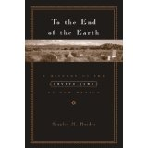
1492 Spanish Inquisition
Crypto Jews
Sephardic Jews
Fled to New Mexico to escape the persecution of the Catholic Church
Maintained cultural & religious traditions in secret
To the End of the Earth: A History of the Crypto-Jews in New Mexico by Stanley M. Hordes

Slide 16
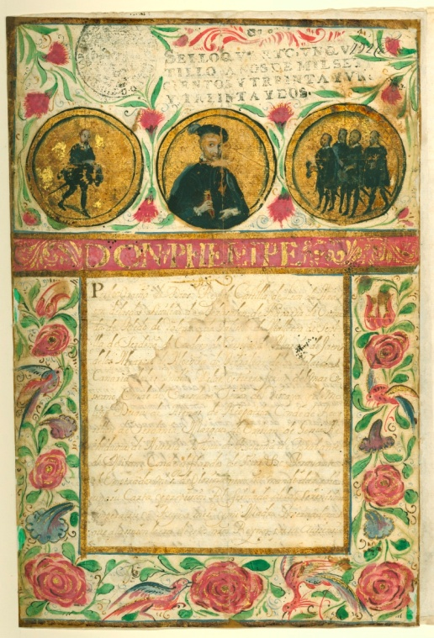
1521 Tlaxcalan agreement with Spain
The “special rights and privileges” awarded to the Tlaxcalans include some important concessions of importance to the Analco district of Santa Fe. The Tlaxcalans would become hidalgos in the conquered lands, settle in their own barrios, bear arms and ride horses, be free from alcabala (sales tax) and sisa (excise tax), and no Spaniard could “take or buy any solar [building house lot] within the Tlaxcalan districts.” (Milford, 1995)

Slide 17
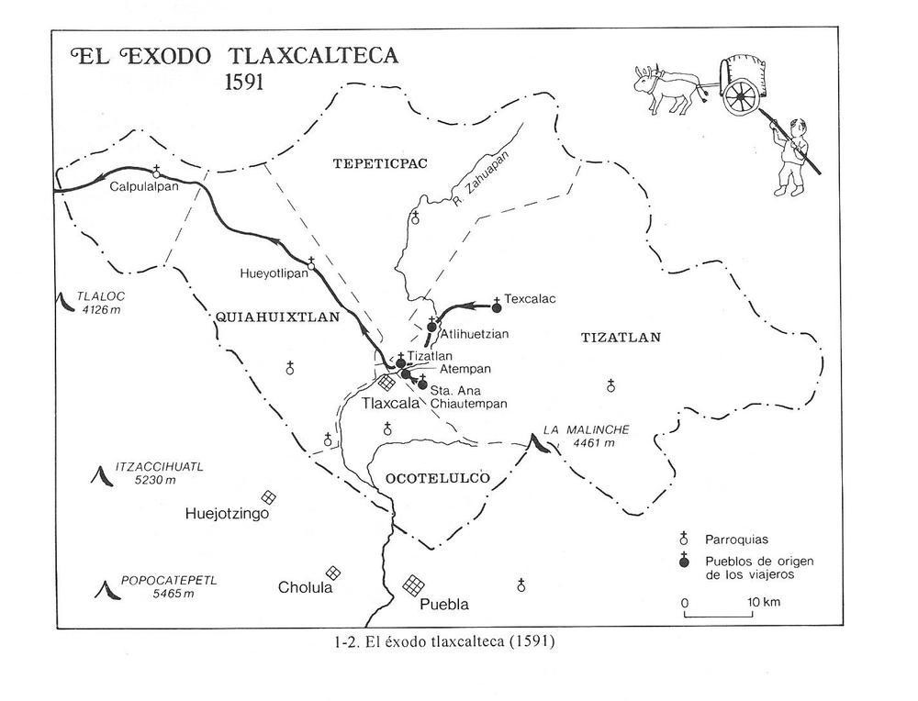
1591 La Migración Tlaxcalteca del Siglo XVI http://usuarios.lycos.es/aime/migralteca.html
“The Tlaxcalteca founded the Mission of San Antonio and the Villa de San Andrés in Texas and also Albuquerque, Analco, and Las Cruces in New Mexico.”

Slide 18
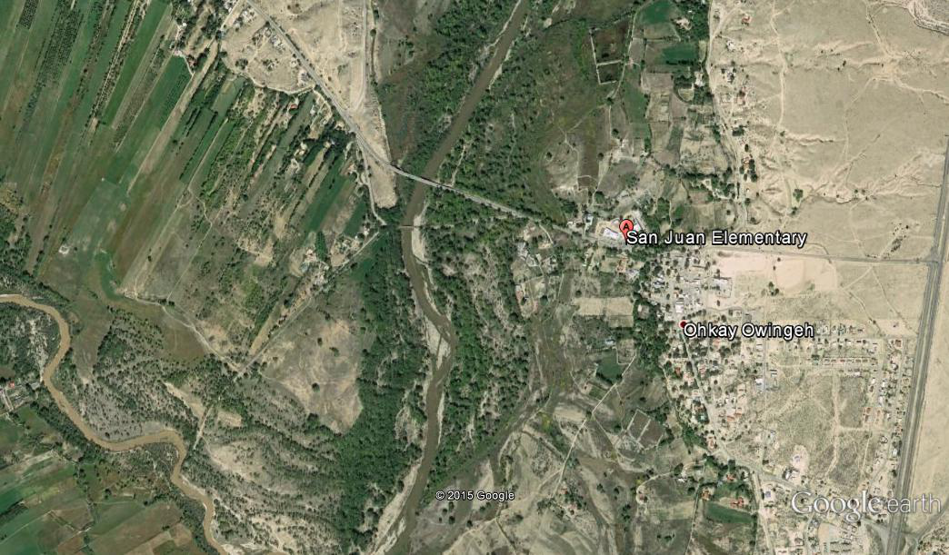
1598 San Gabriel del Yunque
New Mexico Historical Markers
Governor Juan de Onate set up his headquarters in Ohkay Owingeh (formerly known as San Juan Pueblo) in 1598
By 1601 he had moved the Spanish capitol across the Rio Grande to Yuque-Yunque Pueblo.

Slide 19
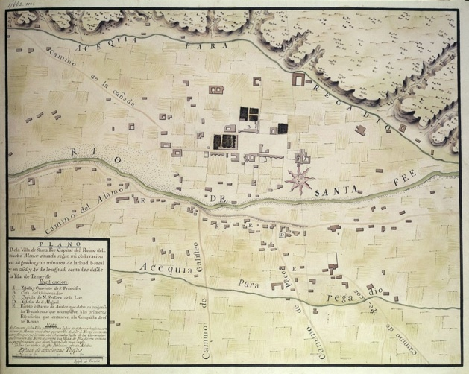
Cir. 1606 La Villa Real de Santa Fe de San Francisco de Asis
The Place names of New Mexico, page 324
“In 1608 Don Pedro de Peralta succeeded Don Juan de Onate as governor of NM, and in the following year he moved the colony’s capital from San Gabriel to the site of an abandoned Indian pueblo.”

Slide 20
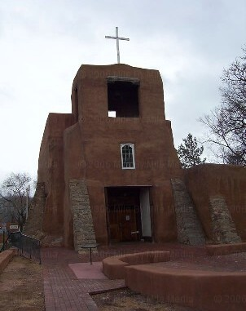
cir. 1609 El Barrio de Analco
Place Names of New Mexico, page 15
“The Indians settled here, on the south side of the Santa Fe River, in a barrio named Analco, in their tongue meaning “on the other side of the water.”

Slide 21
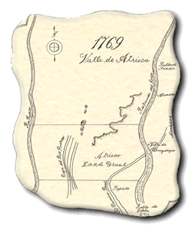
Before 1660 El Barrio de Atlixco
The Place Names of New Mexico, page 24
“Atrisco was initially called Atlixco, after an area in Mexico that was inhabited by Aztecs. Atlixco translates into "surface of a body of water" or "by the water's edge" in their native Nahuatl language. After Spaniards colonized the area, Atlixco became Atrisco due to changing dialects among the colonists.”
Merced de Atrisco Land Grant 1692

Slide 22
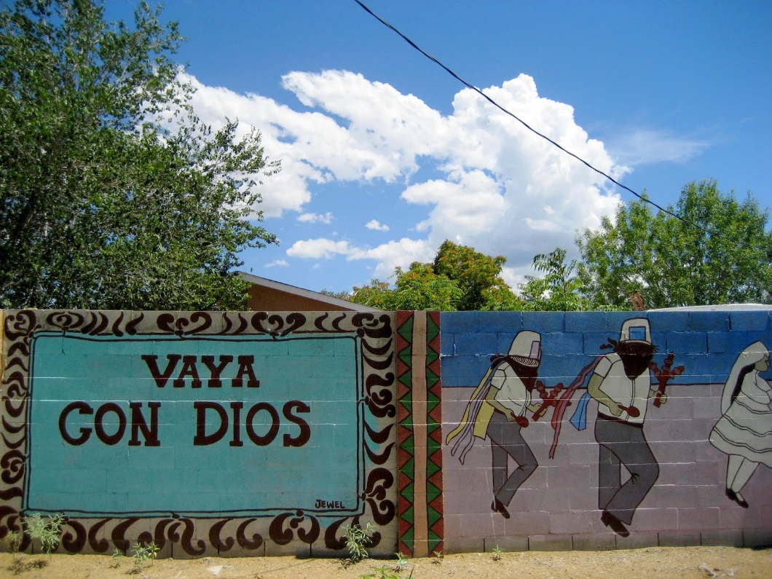
Before 1680 La Angostura de Bernalillo
1696 Real de Bernalillo
50 years later: La Angostura de Bernalillo
The name Bernalillo refers to the Gonzales-Bernal, family, whose members lived here before 1680. Descendants of Pasquala Bernal and Juan Griego.

Slide 23
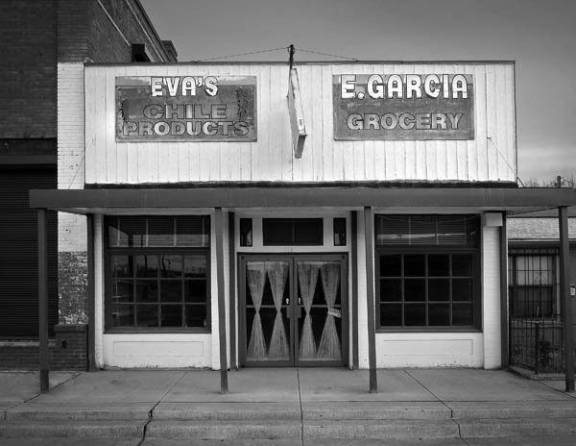
Before 1680 Belen [Los Garcias]
New Mexico Place Names, pages 34 and 145.
“A cluster of Garcia families gave the name Los Garcias to this settlement.”
A village was destroyed in the 1680 Pueblo Revolt.
1740 Nuestra Señora de Belen Land Grant.

Slide 24
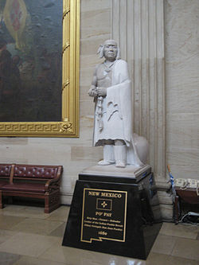
1680 Pueblo Revolt http://www.americanjourneys.org/aj-009b/summary/
“After three generations of oppression, in the spring of 1680, the Pueblo Indians rose up to overthrow the Spanish.”

Slide 25
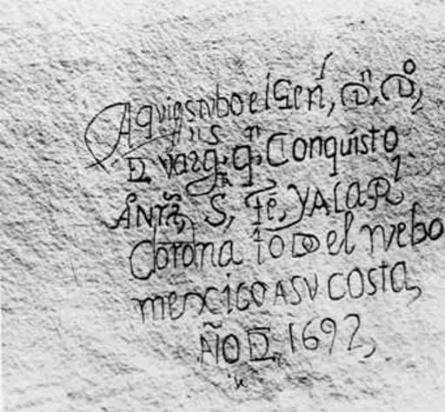
1692 De Vargas Recolonization
“In August 1692, just 18 months after his arrival at El Paso, Vargas led a modest force of less than 200 soldiers, vecinos, and Indian allies north [from Pueblo del Paso, Real de San Lorenzo, Pueblo de Senecu, and Pueblo de Ysleta.]”

Slide 26
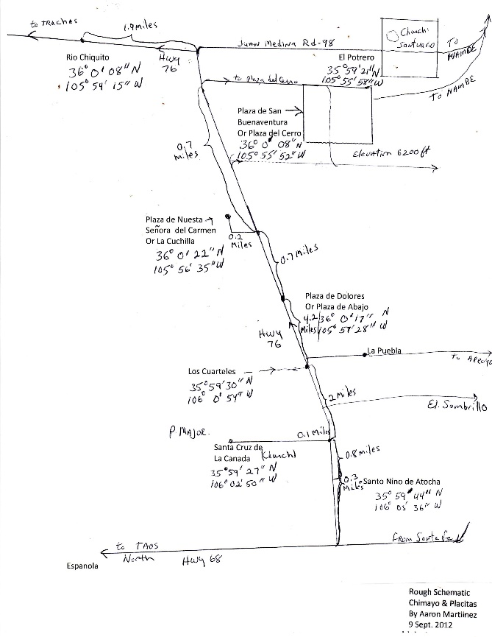
1695 La Villa de Santa Cruz de la Canada
The Place Names of New Mexico, page 324.
Founded by Vargas, in 1695.
This villa was located near the confluence of the Rio Granda and the Rio Chama, not far from the first permanent settlement in NM, San Gabriel.”

Slide 27
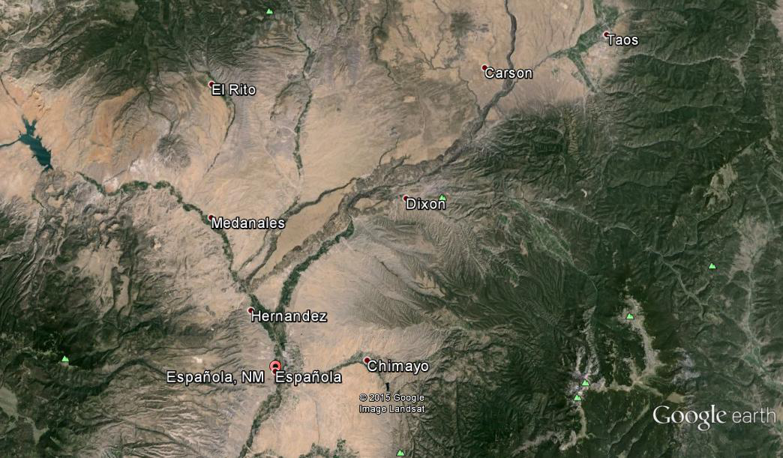
1703 Sebastian Martin Land Grant
“On the north, a cross which was erected on the Canon which ran to El Embudo; on the east, the river which ran between Chimayo and the Pueblo of Picuris; on the south, the north line of the Pueblo of San Juan Grant and on the west, the table lands on the west side of the Rio Grande.”
SOURCE: http://dev.newmexicohistory.org/filedetails.php?fileID=24906

Slide 28
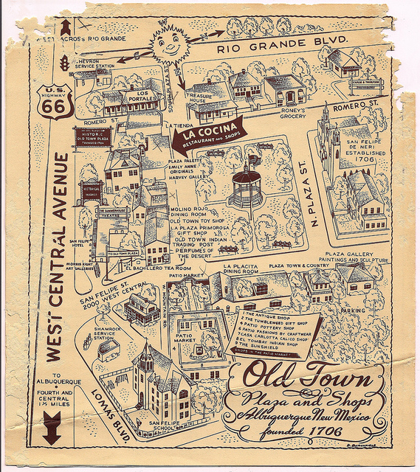
1706 La Villa de San Francisco de Alburquerque [Bosque Grande]
The Place Names of New Mexico, pages 9-11
“In honor of Don Francisco Fernandez de la Cueva Enriques, Duke of Alburquerque, 34th Viceroy of New Spain, then resident in Mexico City.”

Slide 29
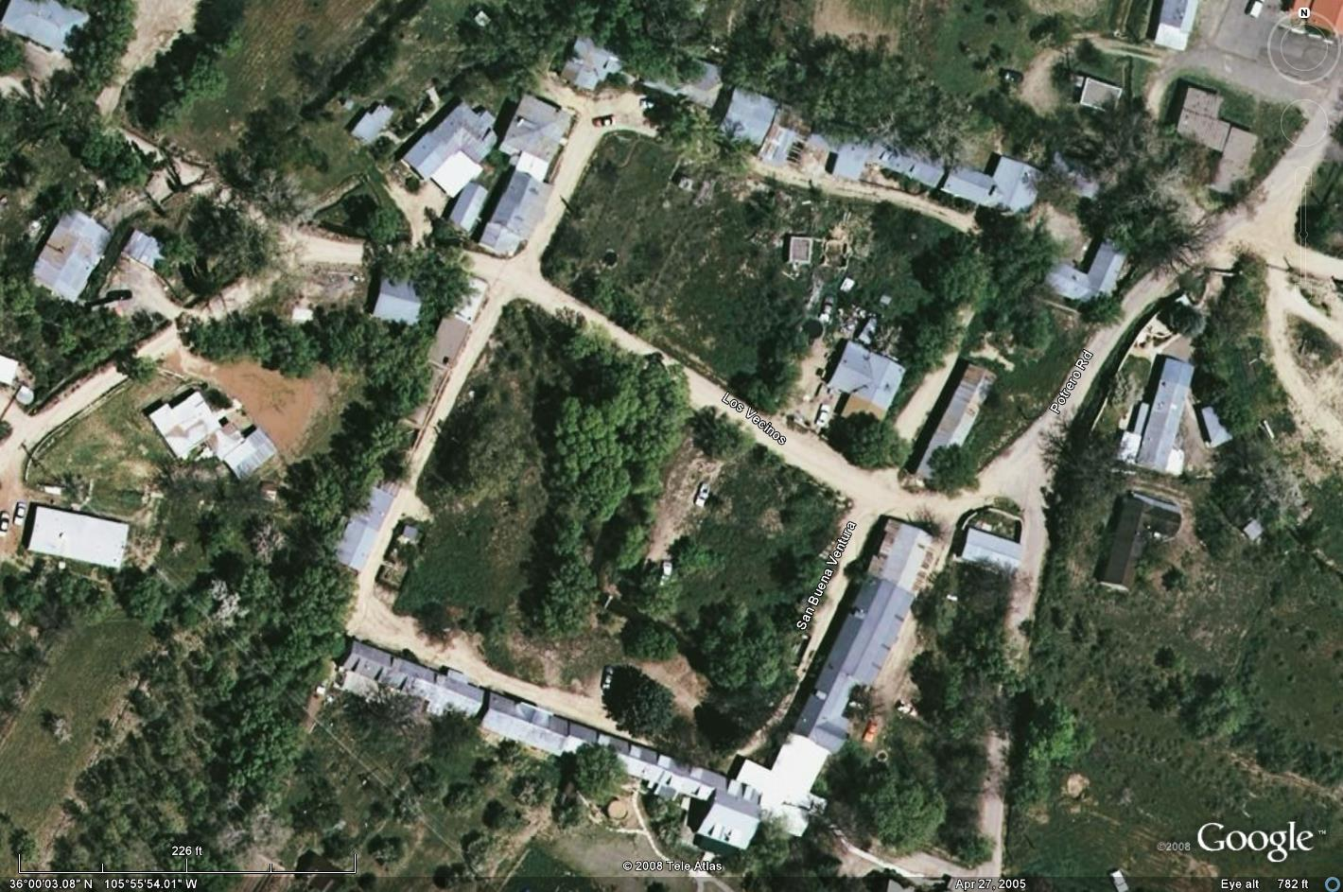
1740 La Plaza de San Buenaventura del Cerro de Chimayó
The Place Names of New Mexico page 81.
Tsimayo [good flaking stone]
“More famous than the village of Chimayó, however, is the shrine known as El Santuario de Nuestro Señor de Esquipulas.”

Slide 30
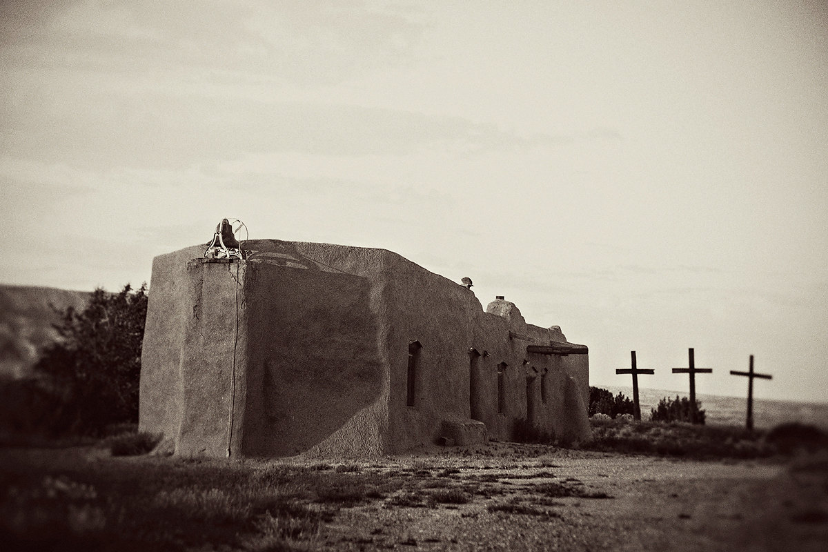
1747 Santa Rosa de Lima de Abiquiu [La Puente]
Place Names of New Mexico, pages 1-2
“The present village of Abiquiu was founded by genizaros, Hispanicized Indians.”
1754 Santo Tomas de Abiquiu

Slide 31
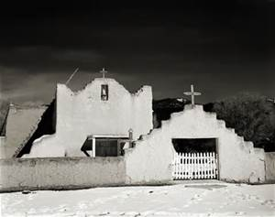
1732 La Misión de San Lorenzo de Picuríes
The Place Names of New Mexico, page 266
Pee-koo-ree-a [those who paint]
Piwetha [pass in the mountains]
1732 San Lorenzo de Picuris

Slide 32
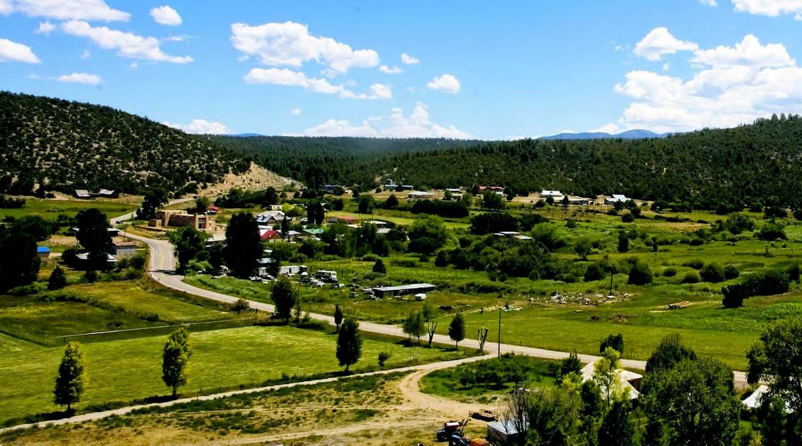
1751 Santo Tomás Apostol del Rio de Las Trampas http://www.lucerito.net/trampas.htm
Trampas was established as a buffer town using the genizaros between the Spaniards and the Indians in the hopes of stopping the Indian raids on the Spanish settlements.

Slide 33
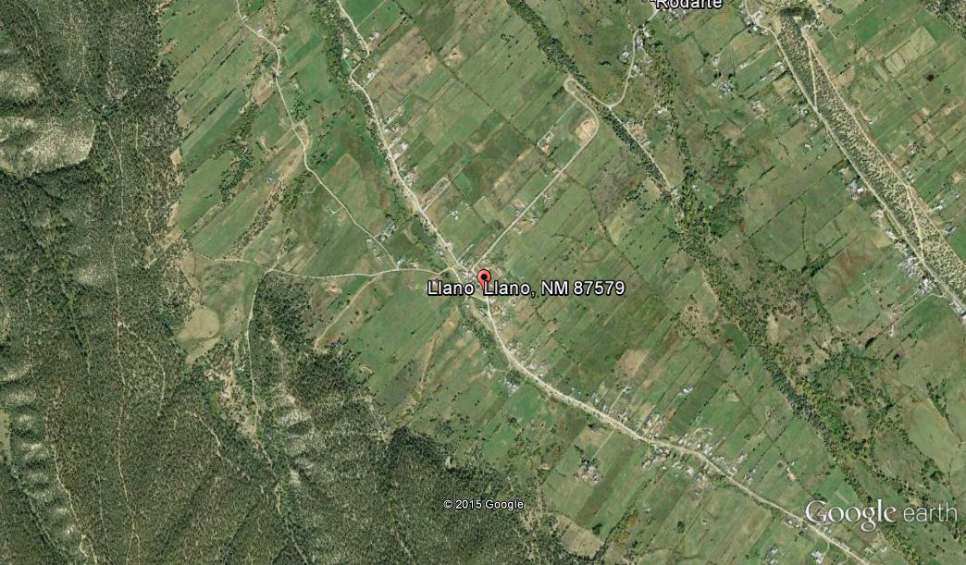
1796 Llano de San Juan Nepomuceno
Alberto Vidaurre @ http://www.kmitch.com/Taos/index.html
La Merced de Santa Barbara Land Grant
The Santa Barbara land grant was granted to Valentin Martin, Eusebio Martin, Jose Olguin, Clemente Mestas and Sixty Seven (67) other unnamed Resident Settlers of the Place of San Jose de las Trampas by Lt. Colonel and Governor, Don Fernando Chacon 11 January 1796.

Slide 34
Estanlislao Andrés Lucero
Email: stanley.lucero@comcast.net
Webpage: www.lucerito.net
Facebook: https://www.facebook.com/stanley.a.lucero
Lucero-Lopez Family Tree on ancestry.com
La Gente del Llano: http://www.findagrave.com/cgi-bin/fg.cgi?page=vcsr&GSvcid=405097
New Mexico Ancestors: https://www.zeemaps.com/map?group=1703834
MADERA, CALIFORNIA

